Slide 1
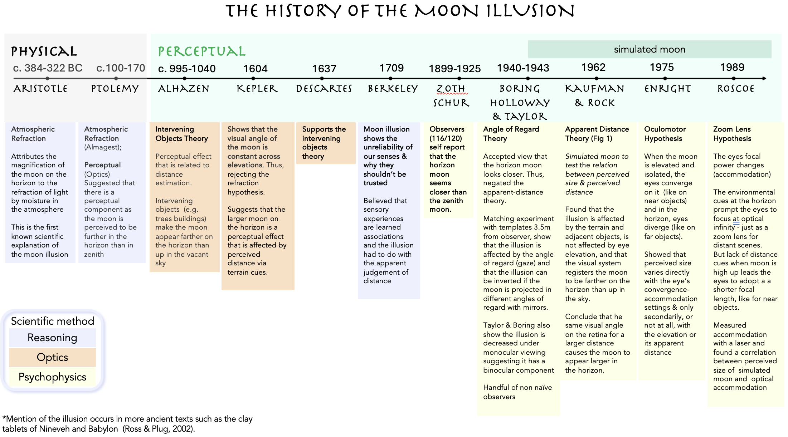
Supplementary Figure 1

Slide 2
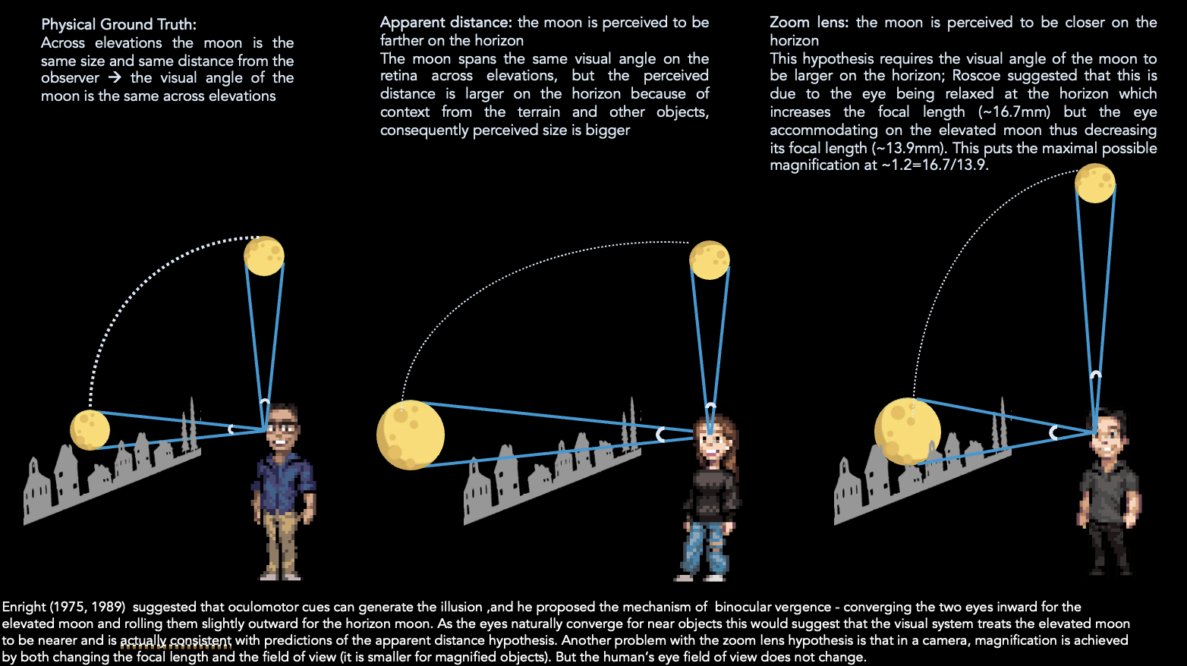

(a) The visual angle of an object on the retina depends on its size and distance
visual angle (VA)
s
d
s = size of object [m]
d = distance of object [m]
$$VA[°]=2∙arctan⁡(\frac{s}{2d})∙\frac{180}{π}$$
(b) Schematics of how visual angle and perceived distance may generate the moon illusion
Supplementary Figure 2

Slide 3
Supplementary Figure 3: quad setup see landscape file

Slide 4
(a)
(b)
Supplementary Figure 5

Slide 5
Supplementary Tables

Slide 6
Supplementary Table 1: Ground Truth Information for the Stanford Moon Study
Object | Diameter [km] | Distance [km] | Visual angle [degrees]
Full moon May 22, 2024 | 3476 | 395236 | 0.5039
Full moon July 20, 2024 | 3476 | 374538 | 0.5317
Full moon July 21, 2024 | 3476 | 370233 | 0.5379
Full moon August 19, 2024 | 3476 | 363081 | 0.5485
Full moon August 20, 2024 | 3476 | 360804 | 0.5520
Full moon October 16, 2024 | 3476 | 357488 | 0.5571
Full moon October 17, 2024 | 3476 | 357252 | 0.5575
Full moon November 15, 2024 | 3476 | 361929 | 0.5503
Full moon January 12, 2025 | 3476 | 379147 | 0.5253
Full moon January 13, 2025 | 3476 | 376953 | 0.5283
Full moon May 13, 2025 | 3476 | 396615 | 0.5021
Full moon August 7, 2025 | 3476 | 390502 | 0.5100
Full moon August 9, 2025 | 3476 | 379992 | 0.5241

Slide 7
Supplementary Table 2: Ground Truth Information for the Stanford Quad Study
Object | Diameter/ Height [m] | Distance [m] | Visual angle [degrees]
Version 1
Lamp bulb 1 | 0.4064 | 62.80 | 0.3710
Lamp bulb 2 | 0.4064 | 20.20 | 1.1530
Lamp bulb 3 | 0.4064 | 50.27 | 0.4630
Lamp bulb 4 | 0.4064 | 34.21 | 0.6810
Lamp post 1 | 2.5908 | 62.80 | 2.3634
Lamp post 2 | 2.5908 | 20.20 | 7.3386
Lamp post 3 | 2.5908 | 50.27 | 2.9522
Lamp post 4 | 2.5908 | 34.21 | 4.3371
Version 2
Lamp bulb 1a | 0.4064 | 66.70 | 0.3491
Lamp bulb 2a | 0.4064 | 22.50 | 1.0349
Lamp bulb 3a | 0.4064 | 48.90 | 0.4762
Lamp bulb 4a | 0.4064 | 32.30 | 0.7209
Inflatable moon ball 1 | 0.5500 | 60.60 | 0.5200
Inflatable moon ball 2 | 0.5500 | 20.80 | 1.5149
Inflatable moon ball 3 | 0.5500 | 47.20 | 0.6676
Inflatable moon ball 4 | 0.5500 | 32.70 | 0.9637
Version 3
Spike ball | 0.2674 | 15.20 | 1.0079
Lamp bulb 5 | 0.4064 | 16.90 | 1.3777
Lamp bulb 6 | 0.4064 | 29.80 | 0.7814
Lamp bulb 7 | 0.4064 | 61.10 | 0.3811
Lamp post 5b | 2.8956 | 23.18 | 7.1480
Lamp post 7 | 2.8956 | 61.10 | 2.7148
Lamp post 8 | 2.8956 | 107.00 | 1.5504
Lamp post 9 | 2.8956 | 151.00 | 1.0987
Lamp post 9a | 2.8956 | 151.89 | 1.0923
* one participant was run on lamp bulbs 1a-4a and lamp posts 1a-4a
Lamp post 1a | 2.5908 | 66.70 | 2.2252
Lamp post 2a | 2.5908 | 22.50 | 6.5901
Lamp post 3a | 2.5908 | 48.90 | 3.0349
Lamp post 4a | 2.5908 | 32.30 | 4.5933

Slide 8
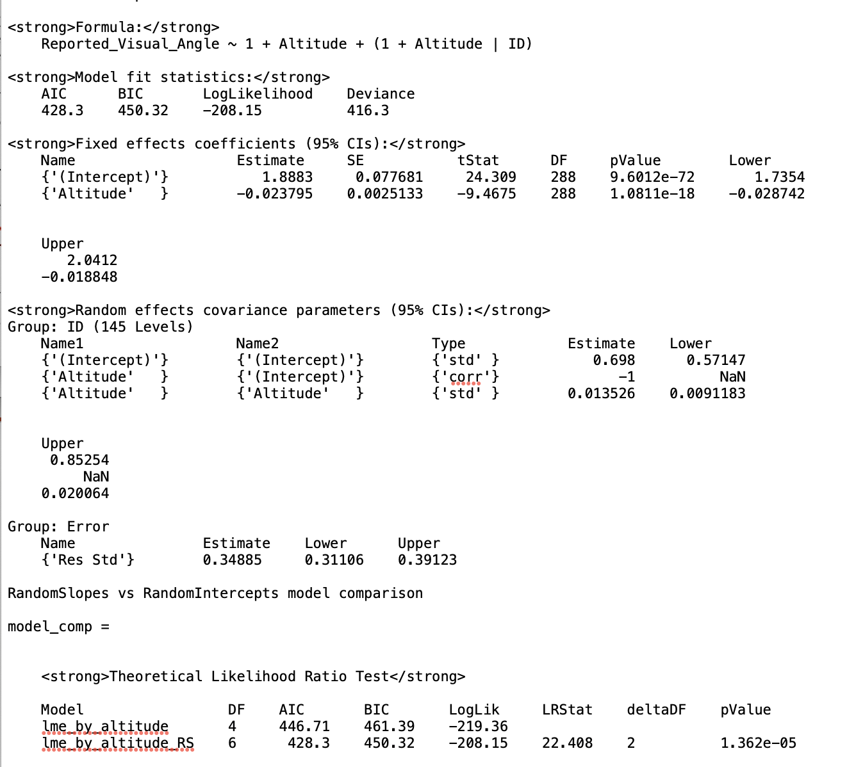
Supplementary Table 2: Experiment 1 LMMs

Slide 9
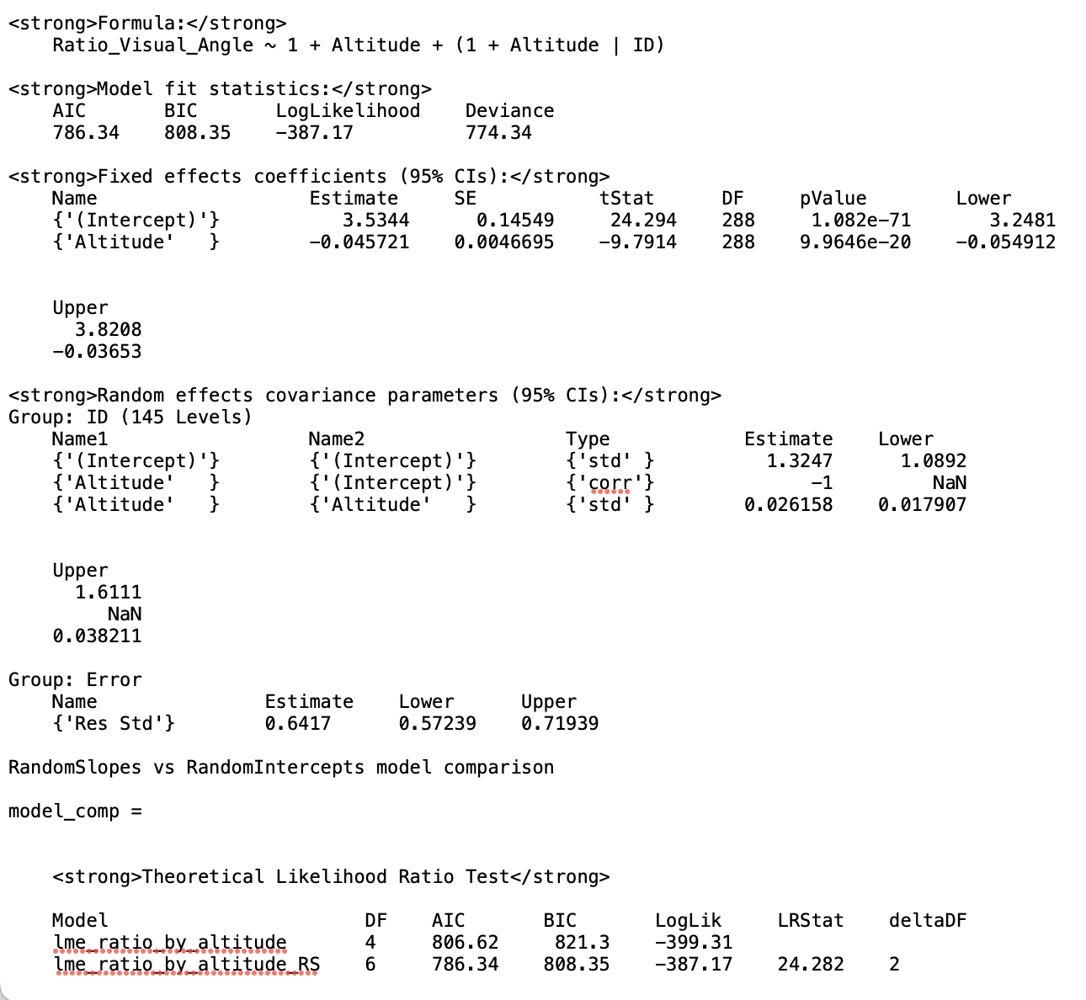

Slide 10
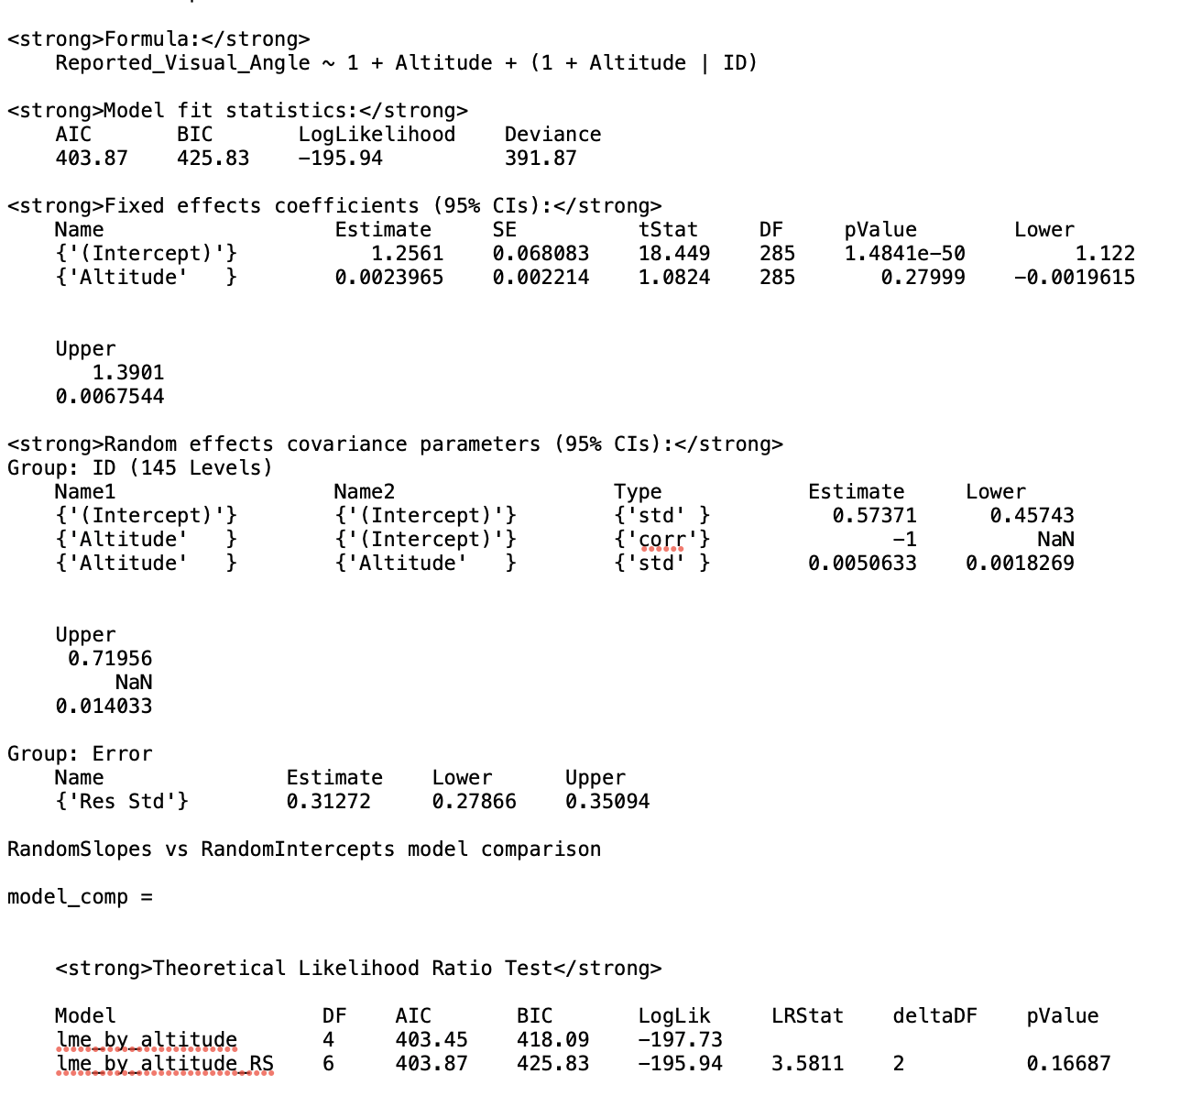
Supplementary Table 3: Experiment 2 LMMs

Slide 11
